Slide 1
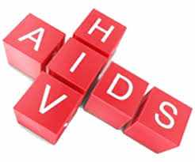
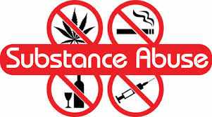
Water Sector Trust Fund
HIV/ AIDS, STDs and substance abuse
Version:2.0 Last Update: August 2017

Slide 2
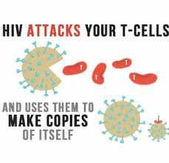
What is it?
HIV means Human Immunodeficiency Virus and AIDS means Acquired Immunodeficiency Syndrome

Slide 3
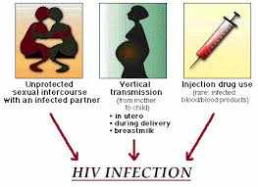
How to contract HIV/AIDS and STD’s
Engaging in unprotected sex
Receiving contaminated blood transfusions
The use of unsterilized needles (substance abuse, tattoos, skin piercings)
Receiving contaminated organs during transplants

Slide 4
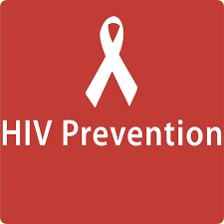
Reducing the risks (guidelines)
Always use condoms
Obtain prior status tests (before you start any sexual activities with a person)
Disclose your status to your partner
Never share needles
Develop trust and communication with your partner
Avoid multiple sexual partners

Slide 5
Reasons for reluctance to use condoms
Cultural factors
Religious factors
Lack of familiarity
People fear that sex will be less enjoyable
Stigma associated with the use of condoms

Slide 6
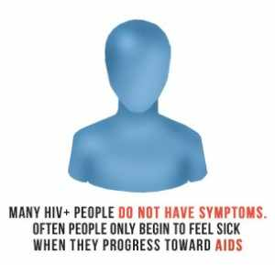
Signs and symptoms of HIV/AIDS
Major signs:
Weight loss
Chronic diarrhea
Cervical cancer
Intermittent and constant fever for over one month

Slide 7
Signs and symptoms of HIV/AIDS
Minor signs:
Persistent cough
Generalized itching condition
Thrush
Generalized enlarged lymph nodes
Recurrent shingles (herpes zoster)
Progressive and disseminated herpes simplex infection

Slide 8
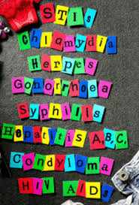
Relationship between HIV/AIDS and Sexually Transmitted Infections (STIs)
Both transmitted through sex
They share the same risk factors
Both are controlled the same way
STIs are risk factors for HIV infections

Slide 9
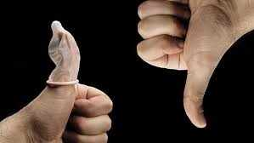
Public health importance of HIV/AIDS and STIs
They are transmitted the same way
They spread rapidly
They cause inevitable death
They have far reaching consequences for the family, community and the country

Slide 10
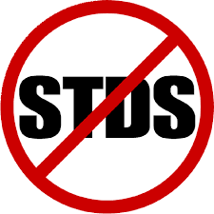
Effects HIV/AIDS and STD’s have on the family
Loss of care and emotional support
Decline in nutritional status
Orphans leading to street children
Loss of rights and position in the family
School dropouts
Lack of income
Stigmatization
Infertility

Slide 11
Effects HIV/AIDS and STIs have on the community and country
Less economical production
Loss of skilled personnel
Society loses in investments and leadership
Population decreases
Health sector spends billions on provision of medication and care

Slide 12
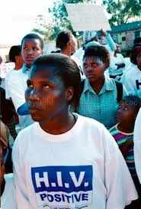
Government policies on HIV/AIDS and STD’s
Promotion of behavior change awareness
Treatment and control of HIV and STIs is free
Encouraging prevention of mother to child transmission of HIV
Encouraging transmission of screened blood and organs for the transplant

Slide 13
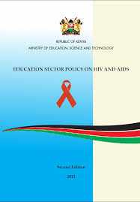
Government policies on HIV/AIDS and STD’s
Free provision and supply of condoms
Encouraging male circumcision
Public awareness about HIV (billboards)
HIV /Aids Support groups

Slide 14
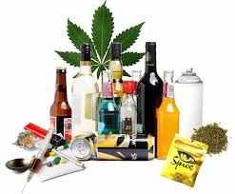
Substance Abuse (Drug Abuse)
Is a use of drug in which the person takes the substance in amounts or with methods which are harmful to themselves or others
Examples of abused drugs
Alcohol
Miraa
Bhang
Tobacco

Slide 15
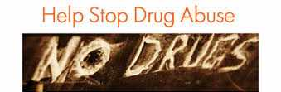
Effects of Substance Abuse
Diseases like:
Liver Cirrhosis
Throat cancer
Bronchitis
Laryngitis
Gum diseases
Infertility

Slide 16
Effects of Substance Abuse
Behavior changes
Violence
Moodiness
Social problems
Psychological problems
Suicides
Homicides
Vehicle accidents
Unprotected sex
Rape

Slide 17
How to control Substance Abuse
Training on behavior change
Motivation
Treatment
Training courses
Counselling
Law enforcement

Slide 18
Thank you!!!
Any questions?
Don’t be shy…

